Slide 1
DevOps

Slide 2
HOW TO BECOME A DEVOPS ENGINEER
1. Learn a programming language
EX: Java , Python, javascript
2. Understand Operating System(OS) Concepts
Process management
I/O management
Threads & concurrency
Virtualization
Sockets
Memory storage
File system
Tip: Linux administration on bootcamp

Slide 3
3. Learn about managing servers
Knowing them is mandatory
Shell scripting : Basht or Ksh
Tools : Find , grep, awk, sed, lsaf
Networking commands : nslookup & netstat
Tip: Linux command line interface (CLI) –plural sight
4. Learn basic networking & security concepts:
You must know basic concepts like:
DNS , OSI Model
HTTP, HTTPS, FTP, SSL/TLS
Tip: TCP/IP and networking fundamentals for IT pro’s – By ED Liberman – plural sight
5. Know the setup & be able to setup
Webserver [lls, apache, Tomcat, Nginx, caddy]
Reverse & Forward proxy
Caching server & load balancer
Firewall
Tip: The web developer boot camp – calt Steele

Slide 4
6. Learn infrastructure as a code which includes:
Containers: Docker, Kubernetes
Configuration management tools : Ansible , chef, Saltstack, Puppet
Infrastructure provisioning’s: Terraform, Cloud Formation
Tip: Docker mastery: Complete Toolset, Learn Devops: The complete kubernetes course –Udemy
7. Learn CI/CD Tools:
Jenkins, Teamcity, CircleCI
Tip: Master Jenkins CI for Devops and Developers –Udemy
8. Learn to monitor software & Infrastructure
Nagios, Promeheus, Splunk, ELK, App Dynamic
9. Learn about cloud providers
Aws , Azure, Google Cloud

Slide 5
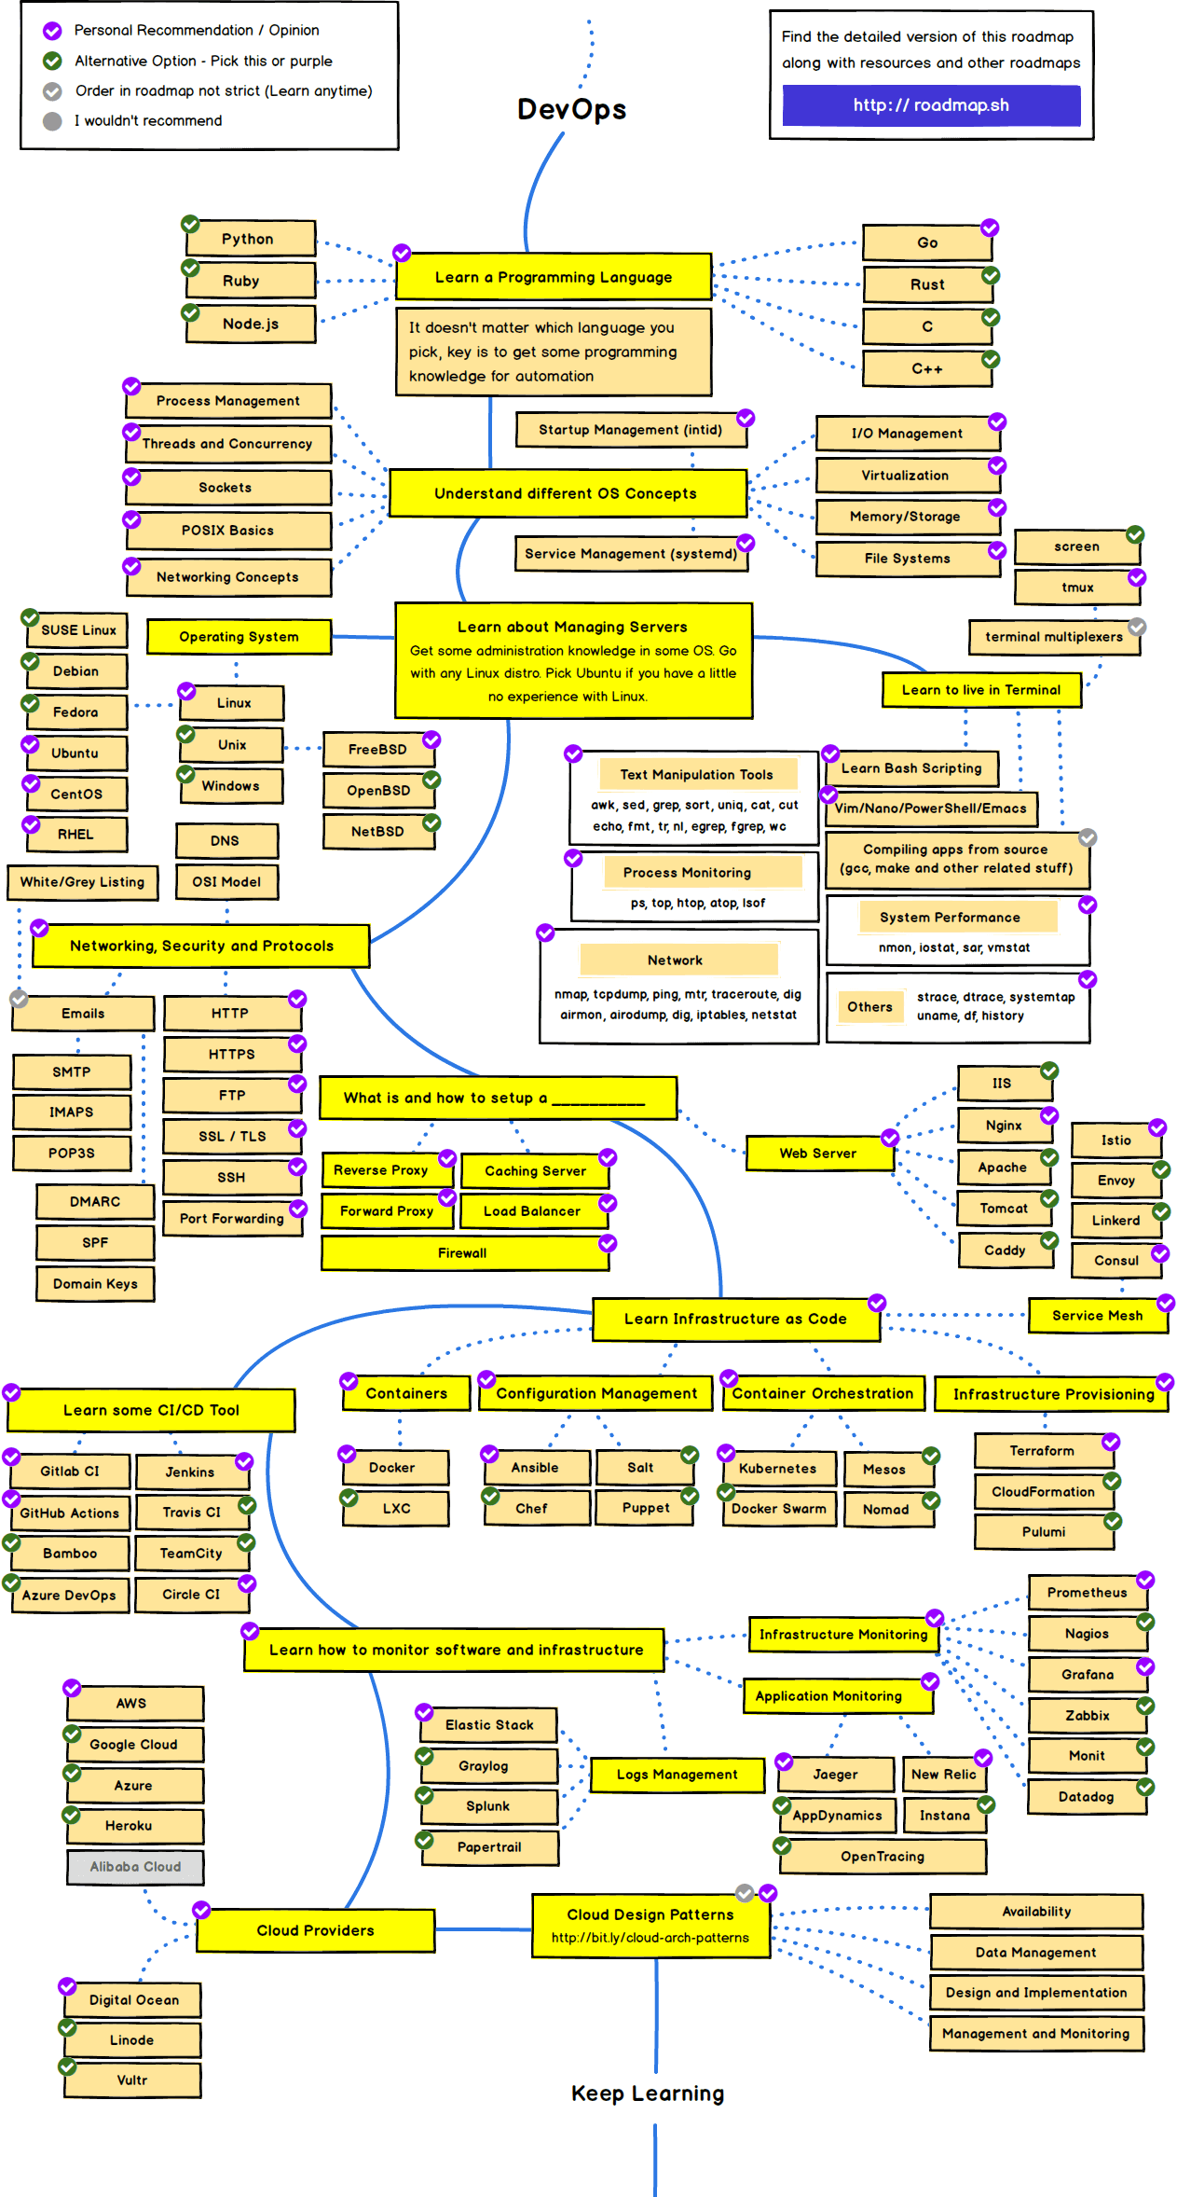

Slide 7
DEVOPS TOOLS
Version Control System (VCS) or
Source code Management (SCM) GITHUB, BITBUCKET
BUILD TOOLS : MAVEN
Code Analysis : Sonarqube
Test : Unit Test
Continues integration (CI) : Jenkins
Artifactory : Jfrog, Nexus
Continues Delivery : Tomact
Dockerization : Docker
Repository : ECR
Orchestration : ECS, Kubernetes, Docker swarm, EKS
Configuration Management : Ansible, Chef, Puppet
Cloud : AWS, Azure, Google cloud
Infrastructure as a code : Terrform

Slide 8
DevOps Engineer Roles and Responsibility
As part of my roles I am responsible to setup and manage CI/CD pipeline.
I have used various Devops Tools like GIT (For VCS), Jenkins (For CI), Maven (As a build tool), Sonarqube (For code analysis), Tomcat (For artifact repository), Ansible (For C. Deployment and configuration management), Docker (For containerization) & Kubernetes (For Container Orchestration), Aws (For Cloud).

Slide 9
More Detailed:
We are using GIT as a
Enable branching strategies
Managing GIT repositories using various GIT commands (Like pull, push, merge, clone, branch, rebase etc).
Managing GIT user access (giving access to specify users)

Slide 10
JENKINS:
Setting Jenkins server
Master and slave configuration
Managing CI/CD jobs
Managing Jenkins plugins
Integration other Devops tools like Git , Maven, Ansible, Sonarqube, Nexus etc

Slide 11
ANSIBLE:
Setting up Ansible control server
Writing playbooks and roles
Managing Ansible hosts

Slide 12
DOCKER:
Setup Docker environment
Writing Dockerfiles
Creating custom images
Setting up private Docker registry
Creating & managing containers

Slide 13
KUBERNETES:
Setup kubernetes environment on AWS or On-Premises
Writing deployment files & service files
Managing containers on pods
Managing kubernetes nodes

Slide 14
Daily Activities:
Start my day with
Checking Emails & Jira Tickets
Checking Notifications from monitoring system
Ensuring that there is not critical alert unattended
Provide help & support to Developers
Providing support for production servers
Automation admin repeated tasks
Creating Jenkins job for Development
Supporting existing infra & creating new servers
Deploying code on Dev & Prod Servers
Checking for proper approvals before code Releases

Slide 15
RESPONSBILITY:
Build & Release process
Managing user access on Resources (Grant/Revoke)
Managing GIT branches
Automation (Jenkins/Ansible)
Server & Applications support
Ensuring Backup & creating Backup policy

Slide 16
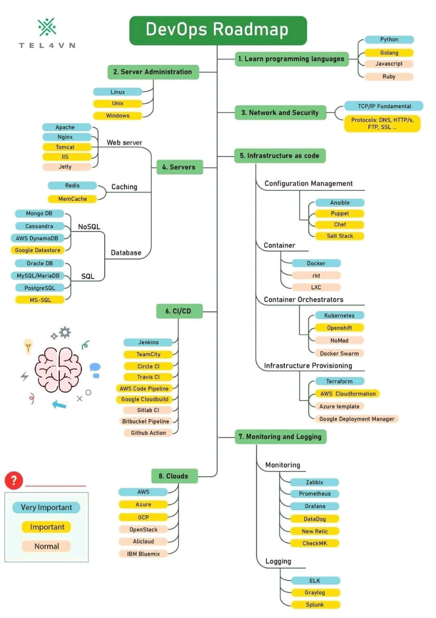
DEVOPS ROAD MAP

Slide 18
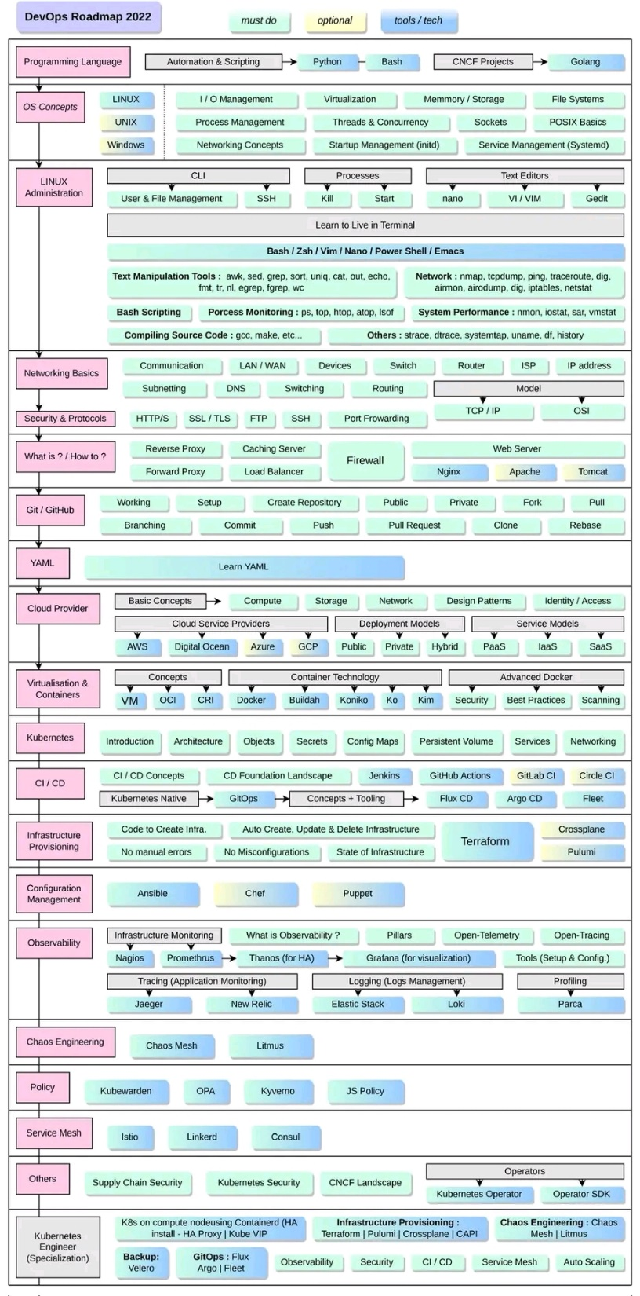

Slide 20
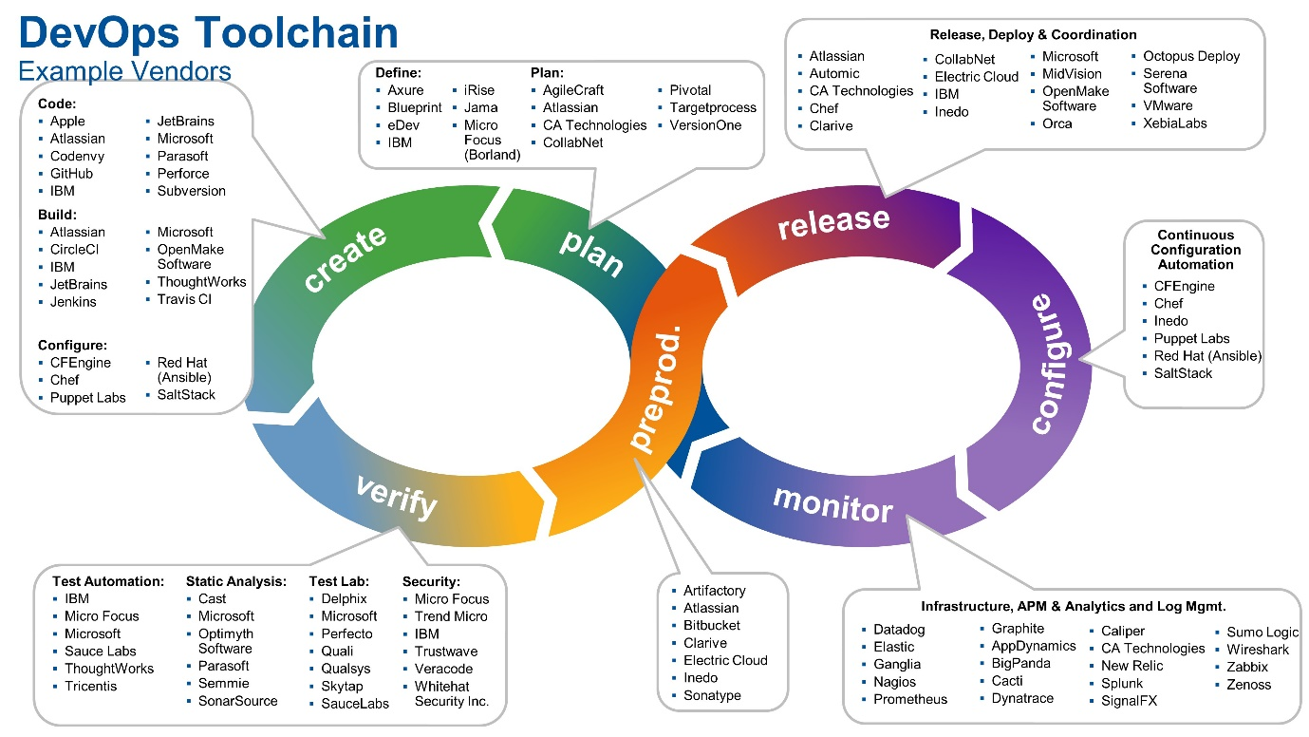
DEVOPS TOOLS

Slide 21
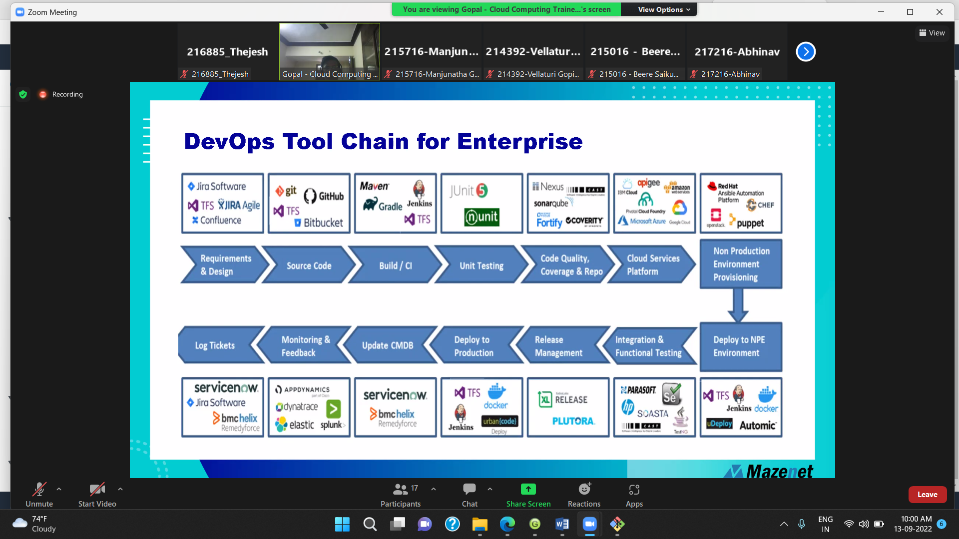

Slide 22
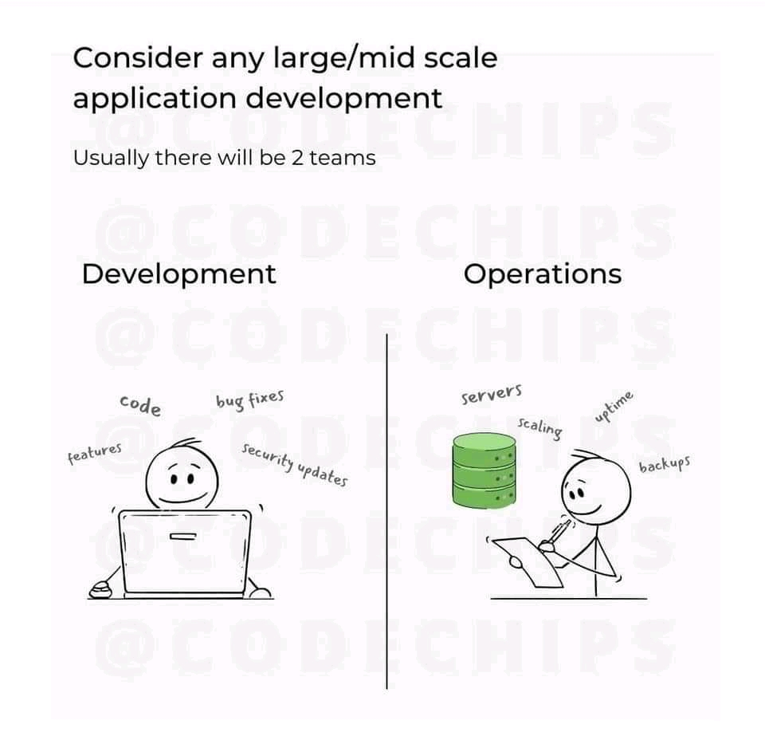
WHAT IS DEVOPS

Slide 23
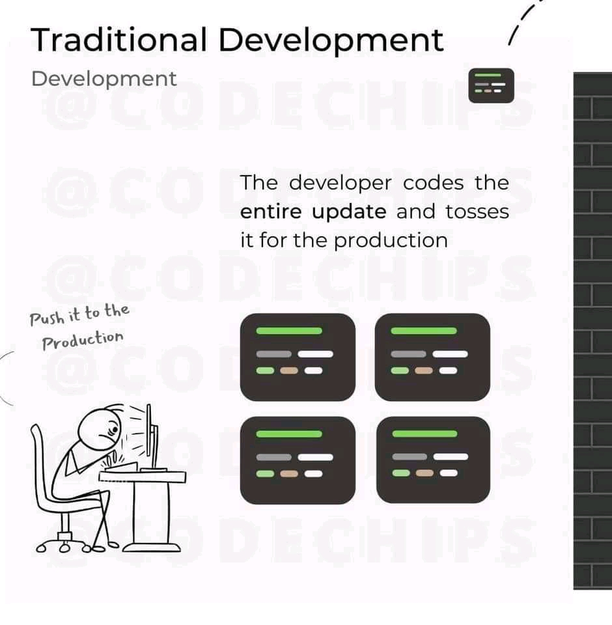
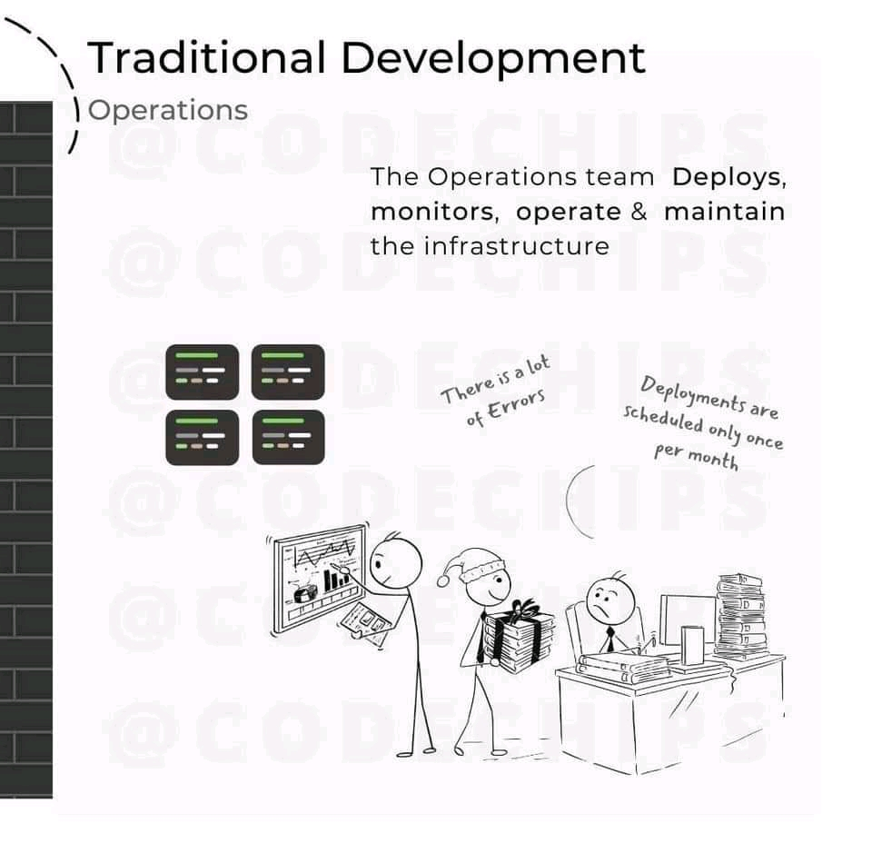

Slide 24
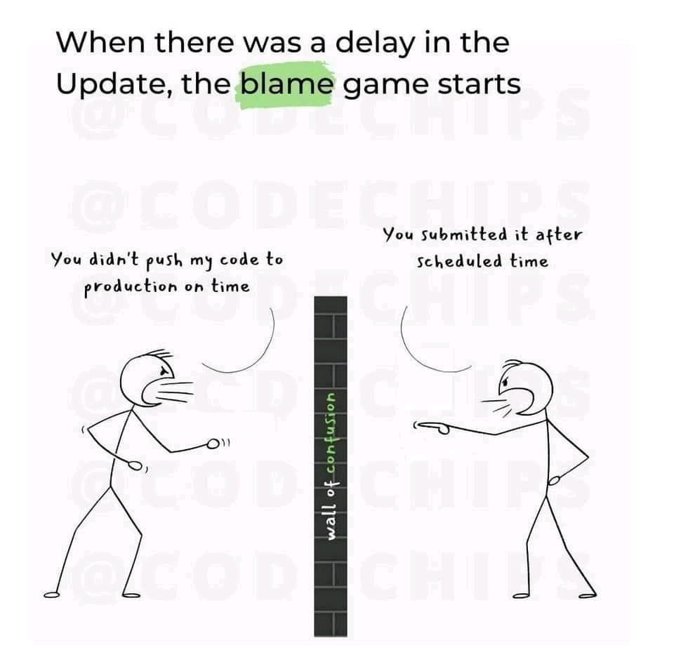

Slide 25
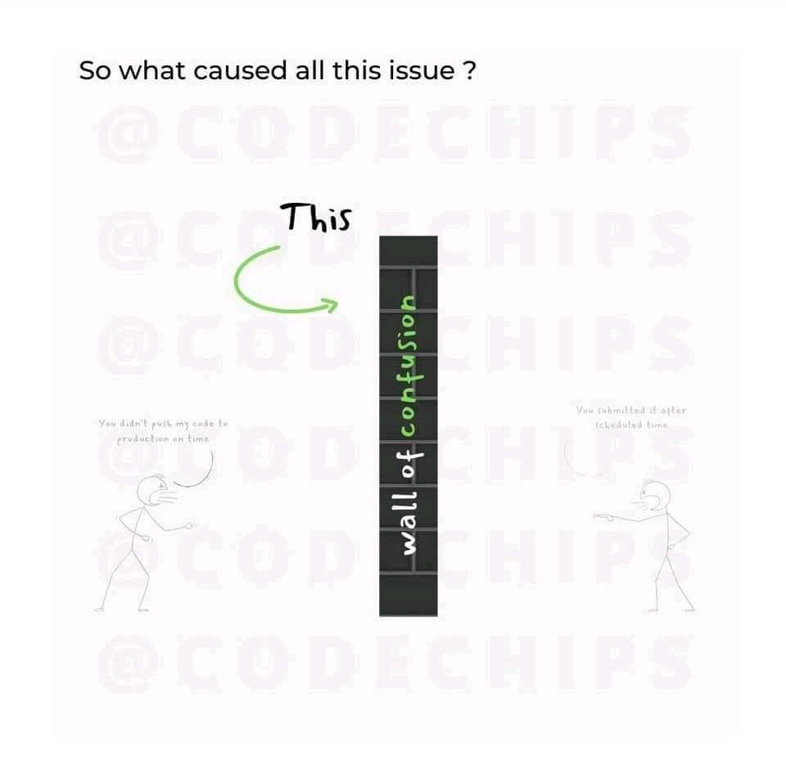

Slide 26
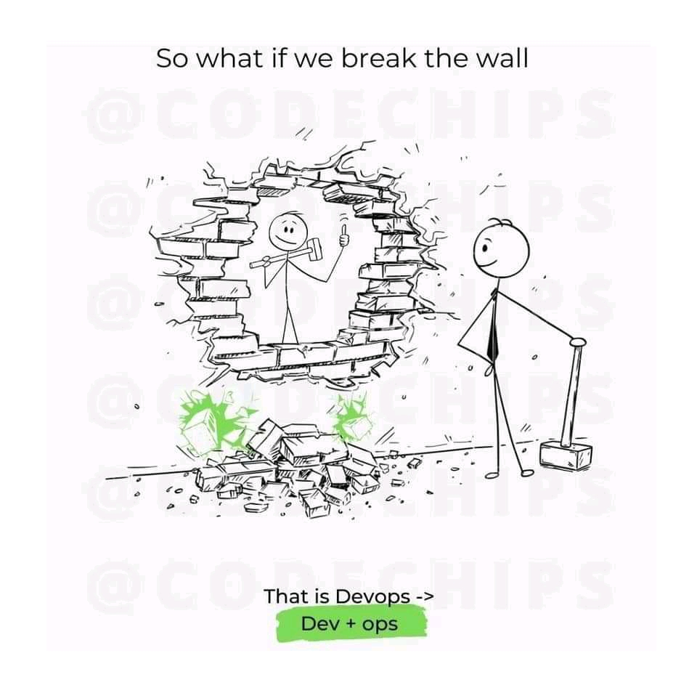

Slide 27
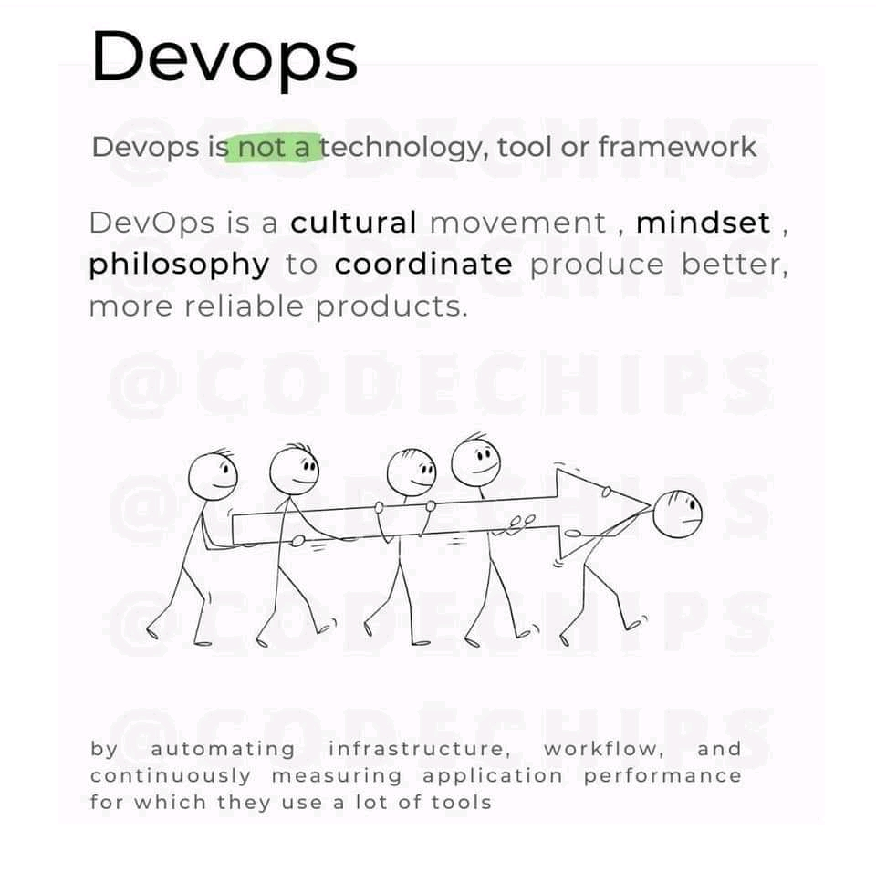

Slide 28
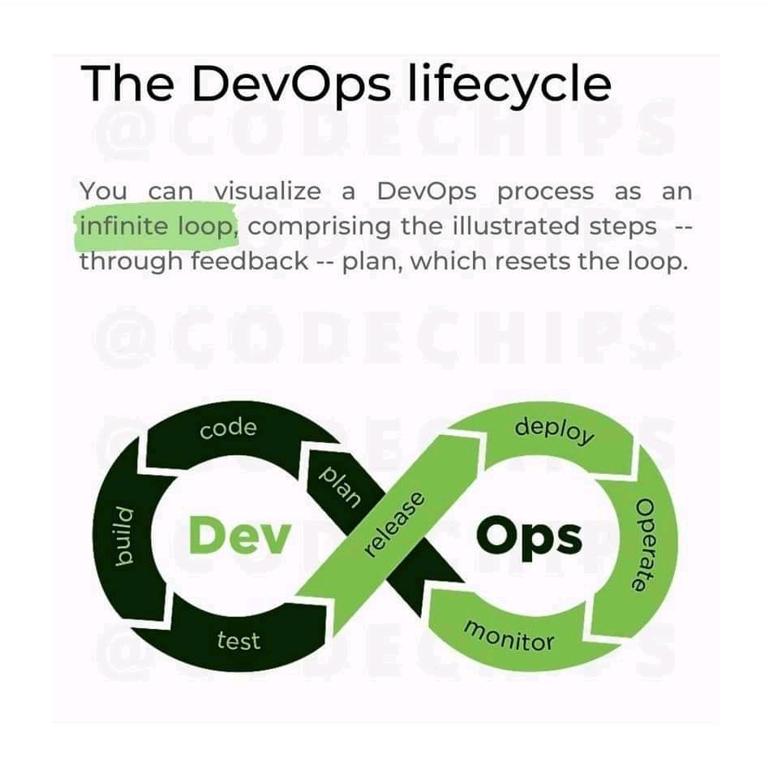

Slide 29
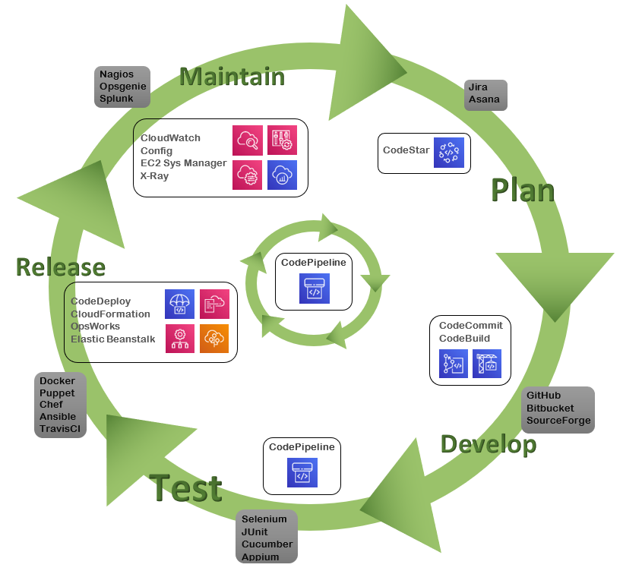

Slide 30
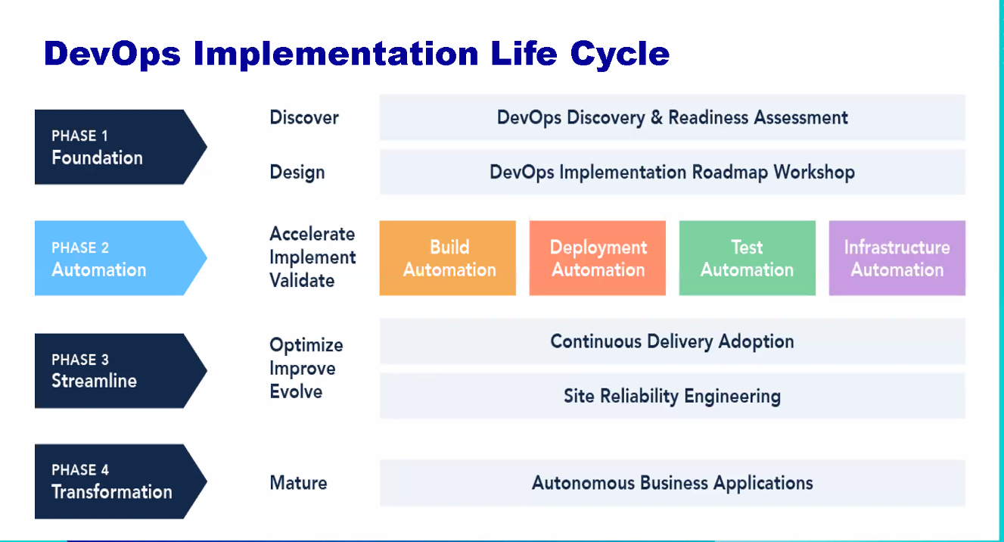

Slide 31
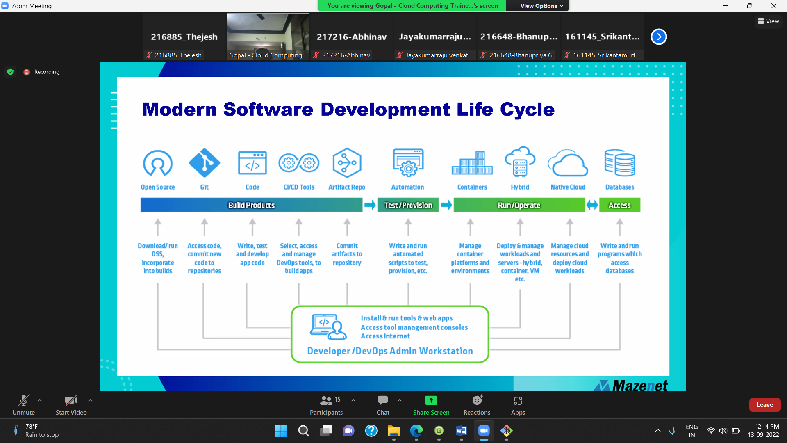

Slide 32
PORTS
Total Numeber of Ports – 65535
Well Known Ports: 0 through 1023.
Registered Ports: 1024 through 49151.
Dynamic/Private: 49152 through 65535.
20 - FTP (data transfer)
21 - FTP (connection establishment)
22 - ssh
23 - telnet
25 - smtp (simple mail transfer protocal)
53 - DNS (Domain Name System)
67 - DHCP (Dynamic Host Configuration Protocol)
80 - httpd
123 - NTP (Network Time Protocal)
143 - Internet Message Access Protocol (IMAP) Management of Digital Mail)
389 - ldap
443 - https
2049 - NFS (Network File system)
3306 – mysql

Slide 33
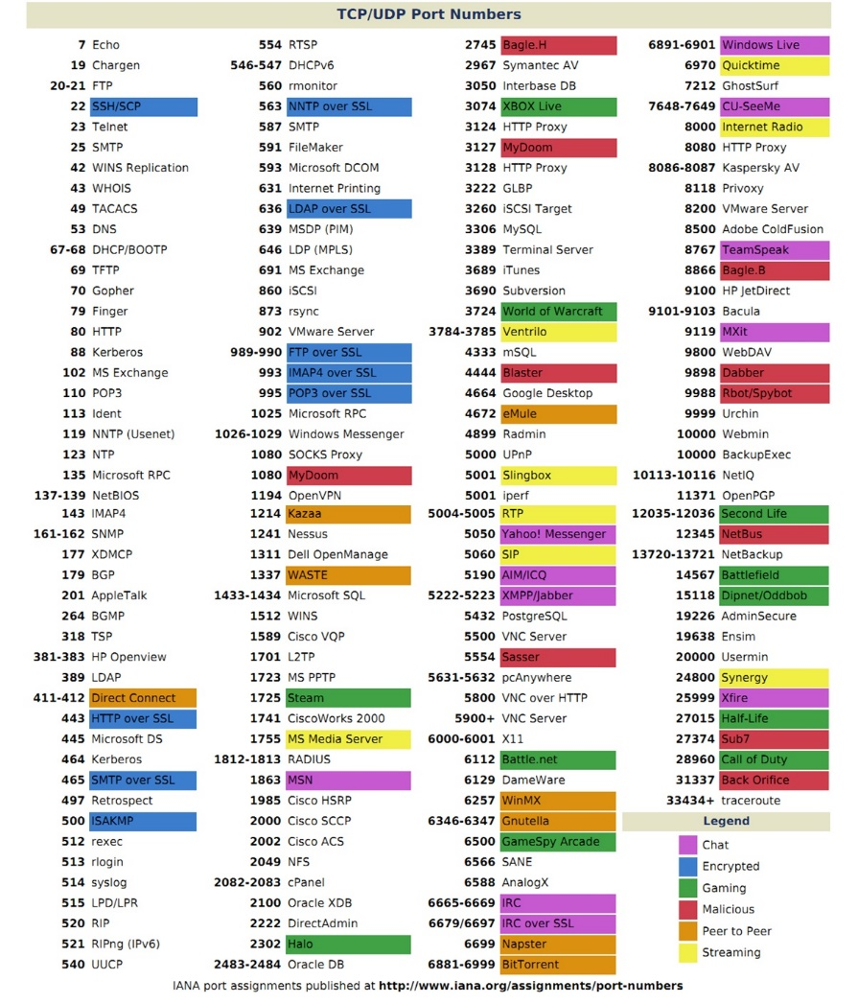

Slide 34
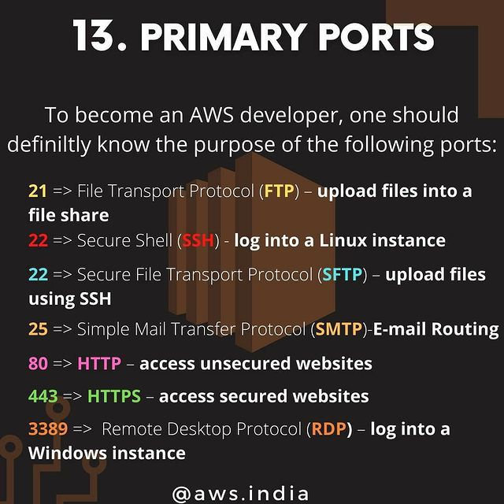

Slide 35
Levels Of Band In Software Engineer
BAND 1
LEVEL 1
Junior Software Engineer
Band 1 Level2
Software Engineer with some experience
Band 2 Level 3
Software Engineer with some experience
Band 2 Level 4
Senior Software Engineer
Senior Software Engineer
Band 3 Level 5
Principal Software Engineer
Band 3 Level 6
Lead Software Engineer
Band 4 Leavel 7
Chief Software Engineer
Band 4 Level 8

